Slide 1
Why social media could be an alternative means of monitoring Air Pollution
For Capstone Project
Gokul Krishna Krishnan

Slide 2
Air Pollution
Because air pollution is not a natural occurrence, but more a societal and business consequence. I chose air pollution as a data science problem because it helps society and there is a lot of data available.
I hope this provides a novel solution to an increasing concern for society and the health of the population.

Slide 3
Harmful affects of air pollution
Asthma
Bronchitis
Emphysema
Heart Disease
Respiratory Failures
Eye irritation
Difficulty breathing

Slide 4
Competitor’s Article
Sensors are Placed in Large City
To Measurement AQI in small places
Air quality index sensor
Carbon monoxide
Nitrogen dioxide
Sulfur dioxide
Particulate matter
Ozone
Using Social Media Analysis to Predict the Air Quality Index Using Text Processing
Uses KNN and Markov Random Filed

Slide 5
Novel Contribution
Objective: reduce number of sensors by predicting the air quality index using means of reading social media.
Because social media is prevelant in the population it produces a lot of data which can be collected and analyzed.

Slide 6
Data
In this Data Set we have values from 2245 sensor with values updated every five minutes and the time range from August 2014 to October 2014.
The Air Quality index values are normalized to range from 25 to 100.

Slide 7
Data
I propose we use Twitter as a form of collection of social media data.
Because its policies are wider in terms for our usage for this purpose.
News organizations and general population use Twitter as a central news reporting.

Slide 8
Data Flow
Sensor Data Set
ARIMA Forecast
Classified Data
Set by Location

Slide 9
Data Flow
Extract Data from Twitter
Filter Relevant Data Set by Text Processing
LSTM for Sentiment Analysis

Slide 10
Data Flow
Match Forecast Accuracy of Twitter Data to the Sensor Data
Outcome to calculate reduction of # of sensors

Slide 11
Method: Air Quality Index - Text Processing
Extract Text
Matching with bag of words
Training SVM for feature
Each feature gets a weight

Slide 12
Method : LSTM For Classification
Long Short Term Memory is type of neural network which uses memory block instead neurons which is efficient in case of classification.
LSTM has three units input gate, output gate and an activation function

Slide 13
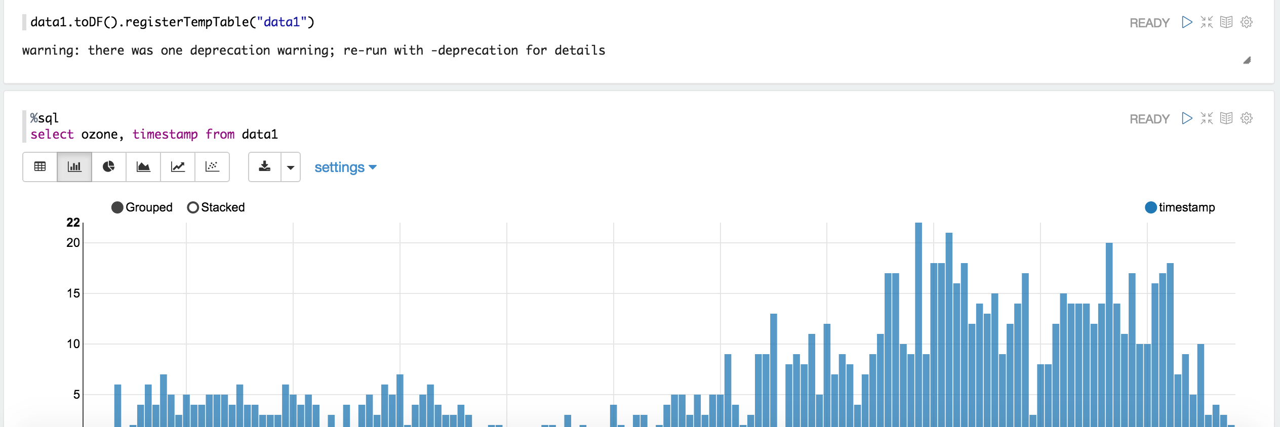
Results
Histogram 1

Slide 14
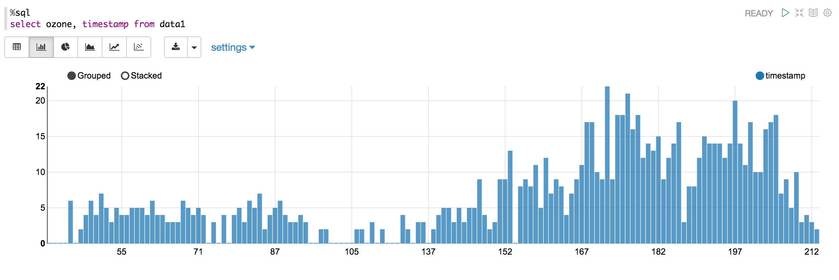
Results
Histogram 2

Slide 15
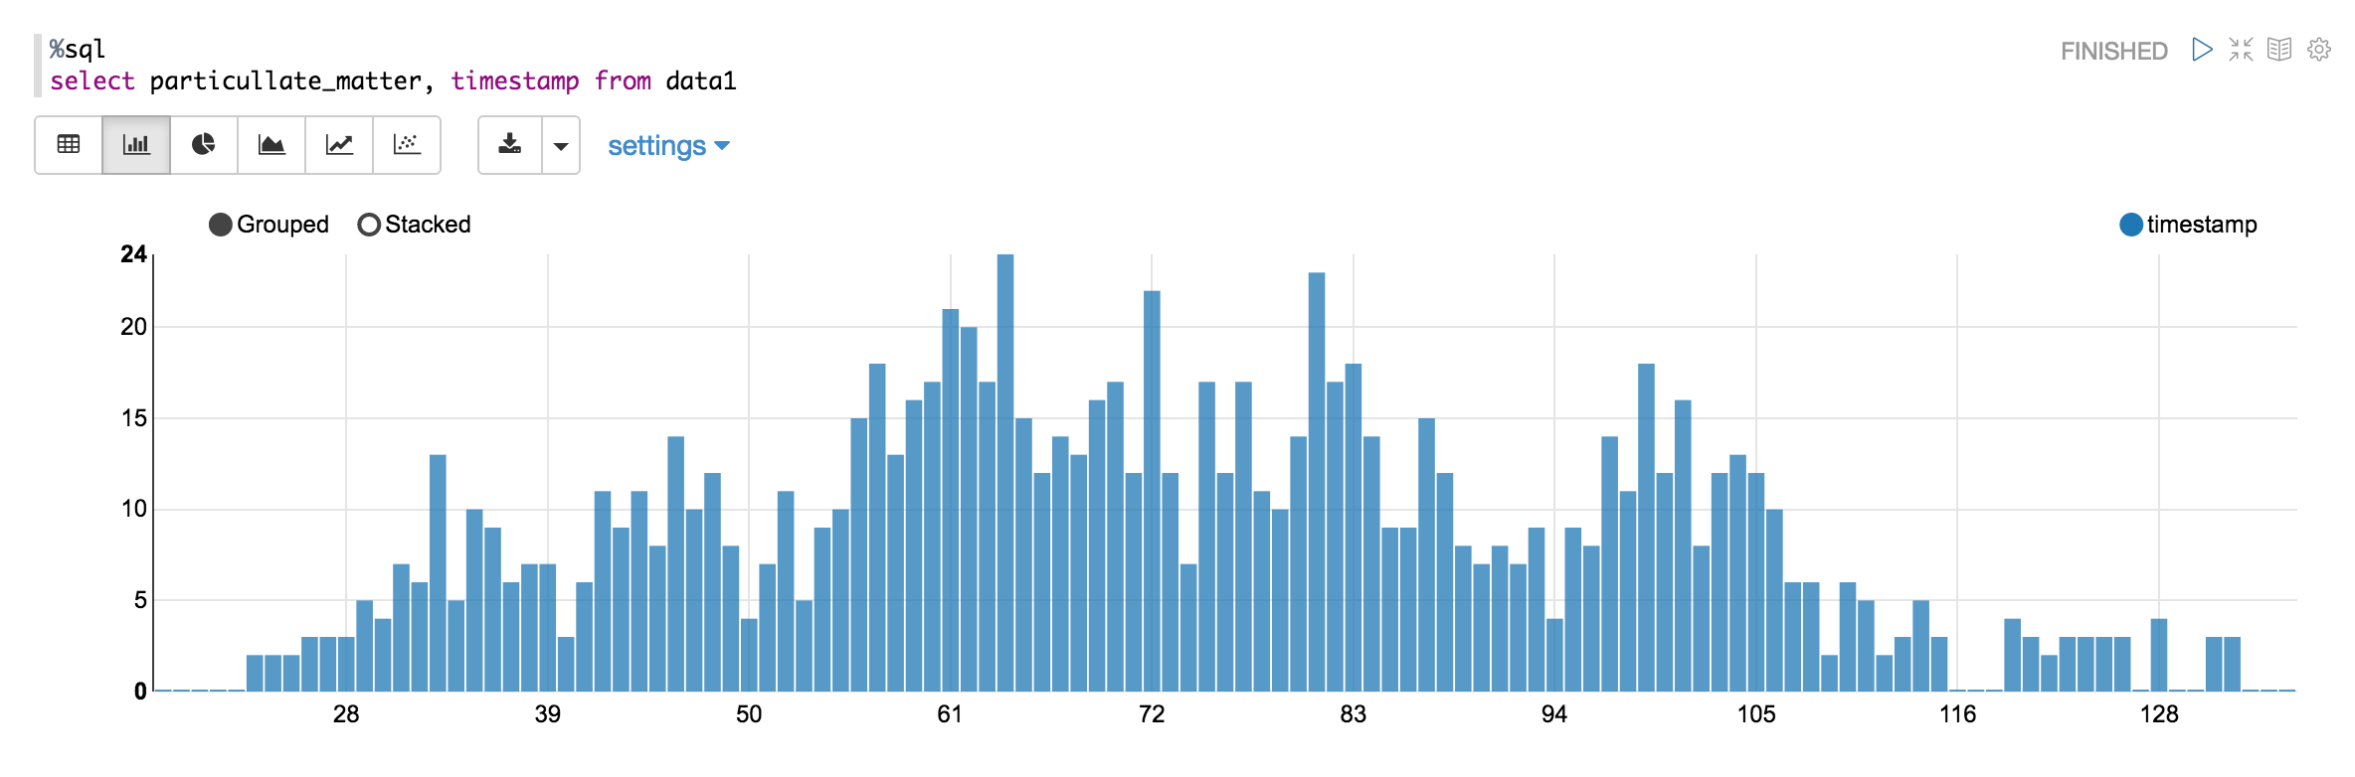
Results
Histogram 3

Slide 16
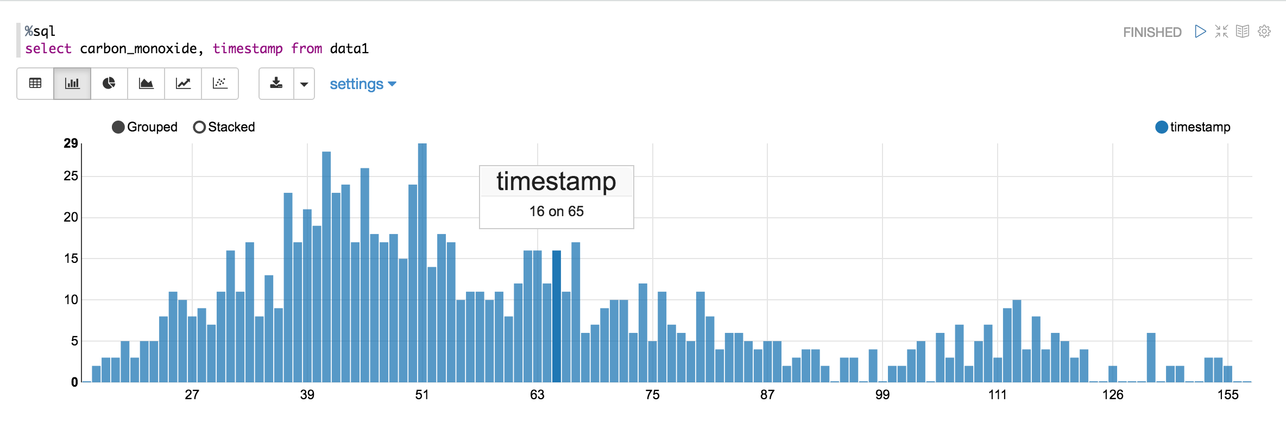
Results
Histogram 4

Slide 17
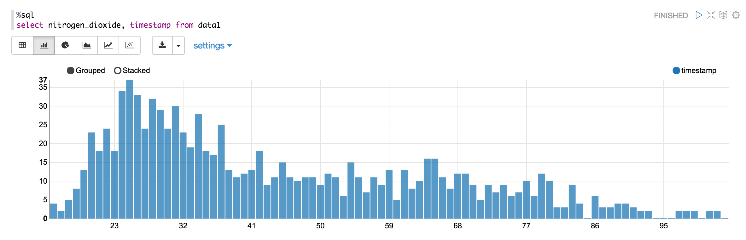
Results
Histogram 5

Slide 18
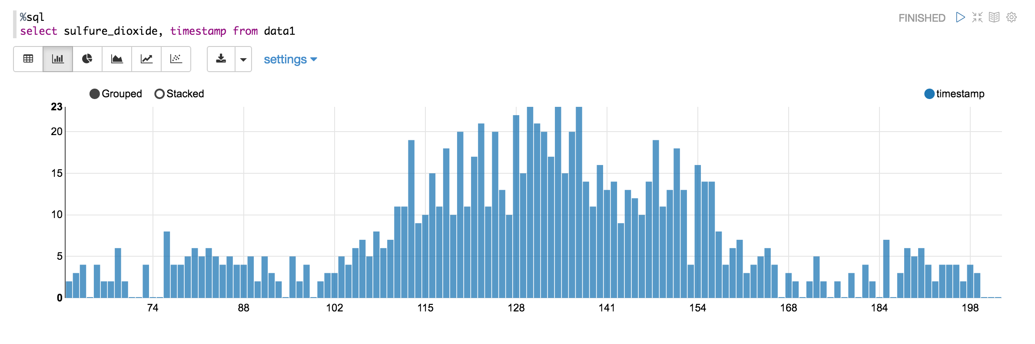
Results
Histogram 6

Slide 19
Results
The Data is extracted and transformed into SQL Table
Histogram results shows that Measurements of each chemical over the time range for all locations

Slide 20
Conclusion
Social media may be a solution to reducing the cost involved in deploying the sensors to monitor air pollution in cities plagued by an increasing rate of pollution.
This will give the government a long term solution utilizing this method.

